Slide 1


Client’s Content Performance

Slide 2


Today's agenda
Project recap
Problem
The Analytics team
Process
Insights
Summary

Slide 3

Social Buzz is a fast-growing technology unicorn that need to adapt quickly to its global scale.
Accenture has begun a 3-month POC focusing on these tasks:
An audit of Social Buzz's big data practice.
Recommendations for a successful IPO.
Analysis to find Social Buzz's top 5 most popular categories of content
Project Recap

Slide 4

Over 100000 posts per day
36500000 pieces of content over year
Analysis to find Social Buzz’s top 5 most popular categories of content
Problem

Slide 5
Process
1
Data Understanding
2
Data Cleaning
3
Data Modelling
4
Data Analysis
5
Insights

Slide 6

Insights
16
Unique
Categories
1897
Reactions to Animal Posts
MAY
Month with Most Posts

Slide 7
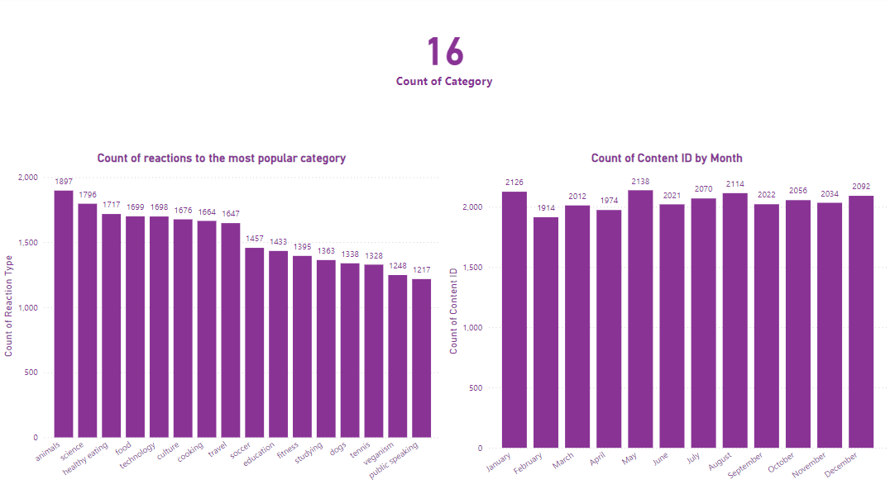

Slide 8
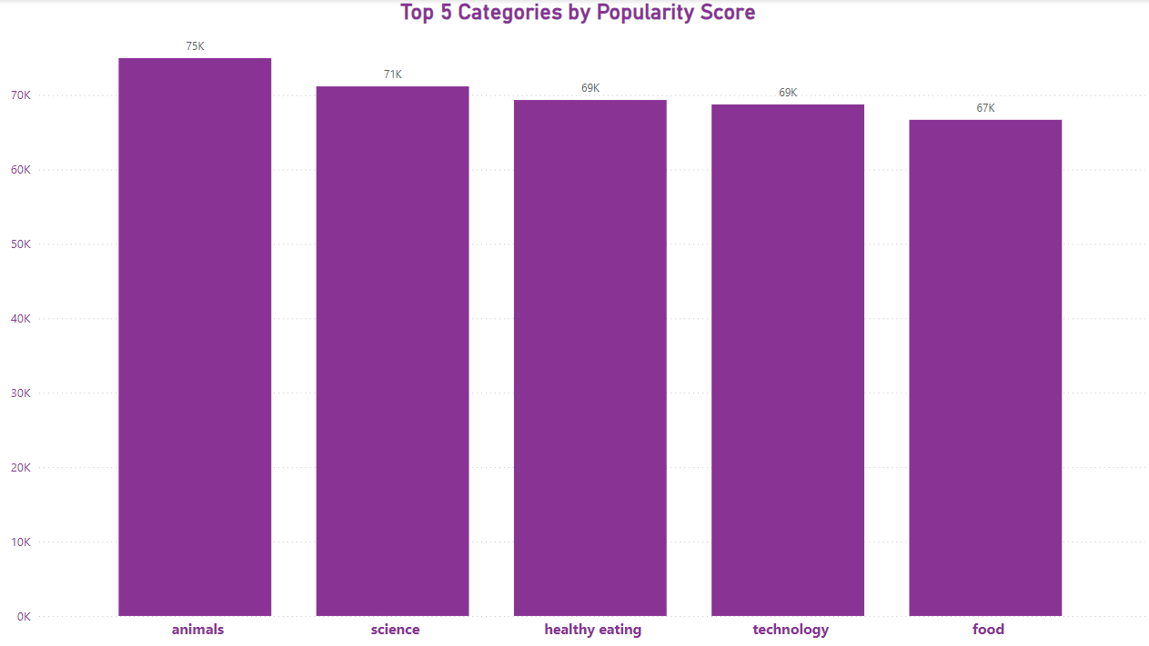

Slide 9
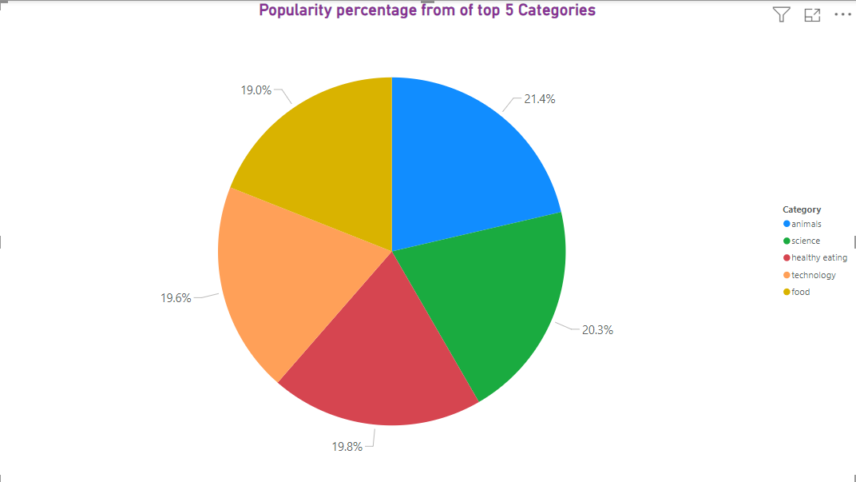

Slide 10

Analysis
Animals and science are the two most
Popular categories of content, showing that
people enjoy "real-life" and "factual" content the most.
Insight
Food is a common theme with the top 5 categories with "Healthy Eating" ranking the highest. This may give an indication to the audience within your userbase. You could use this insight to create a campaign and work with healthy eating brands to boost user engagement.
Next Steps
This ad-hoc analysis is insightful, but it's time to take this analysis into large scale production for real-time understanding of your business. We can show you how to do this.
Summary

Slide 11
Thank you!
ANY QUESTIONS?

